Slide 1


BOOTCAMP TRAINING – IDA
WEEK 4 REPORT
- Neha Juyal

Slide 2
Day – 1
Followings were the learning of Day 1:
Introduction to Azure Storage
Benefits of Azure Storage
Azure Storage data services
Review options for storing data in Azure
Creating a Container
Blob Configuration
Azure Storage Security

Slide 3
Day – 2
Followings were the learning of Day 2:
Introduction to Azure Storage
Benefits of Azure Storage
Azure Storage data services
Review options for storing data in Azure
Creating a Container
Blob Configuration
Azure Storage Security

Slide 4
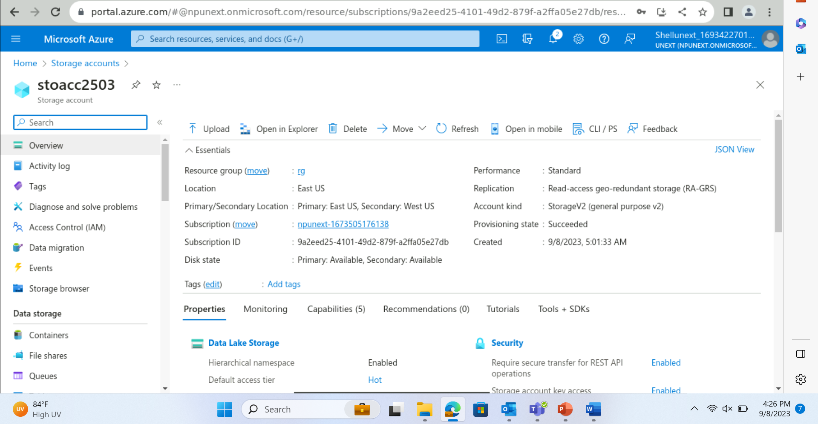

Slide 5
Day – 3
Followings were the learning of Day-3:
Azure Data Lake
Input Datasets
Pipeline
Output Datasets
Linked Services

Slide 6
Day – 4
Followings were the learning of Day-4:
Control Flow Activity
Get Metadata Activity
Filter Activity
Copy Data
ForEach Loop
If Condition
Parameterization
Derived Column
Join
Conditional Split
Assessment / MCQ Quiz

Slide 7
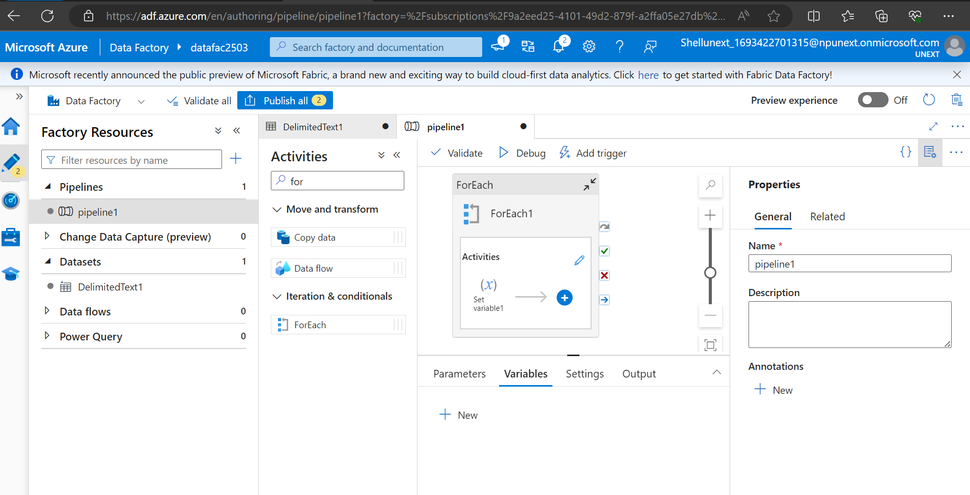

Slide 8
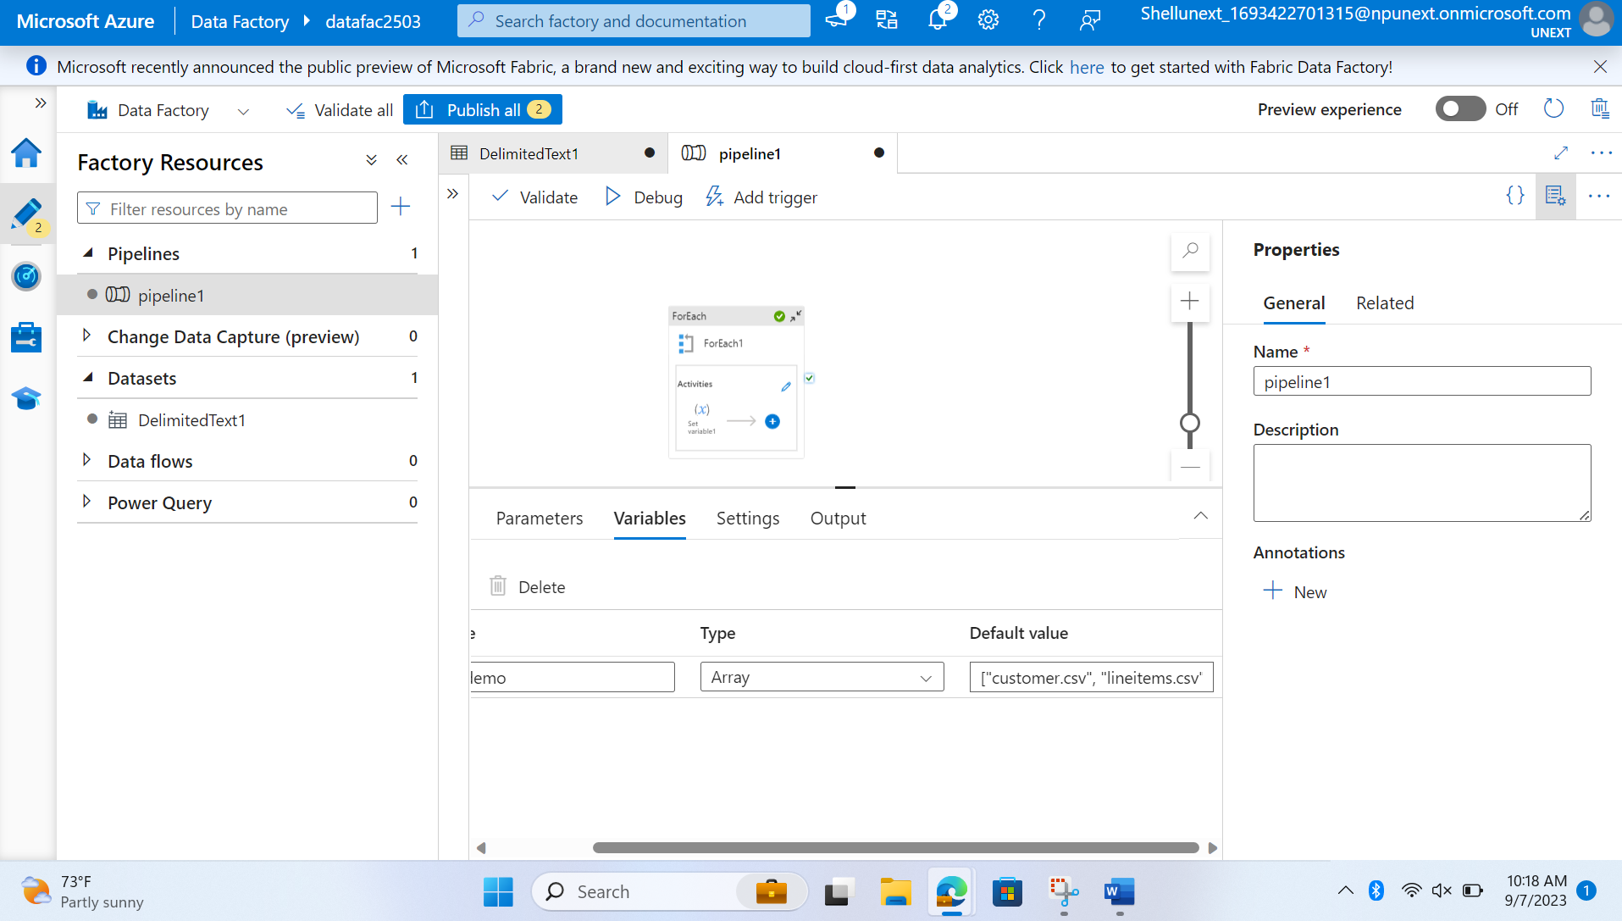

Slide 9
Day – 5
Followings were the learning of Day-7:
Mapping data flows in Azure Data Factory
Change data capture in Azure Data Factory
Mapping data flow Debug Mode

Slide 10
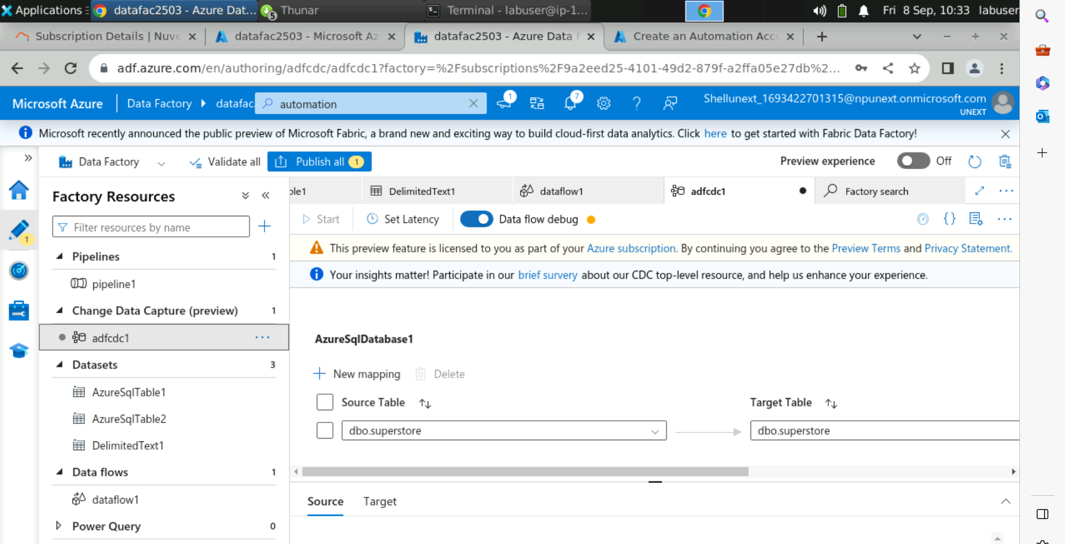

Slide 11
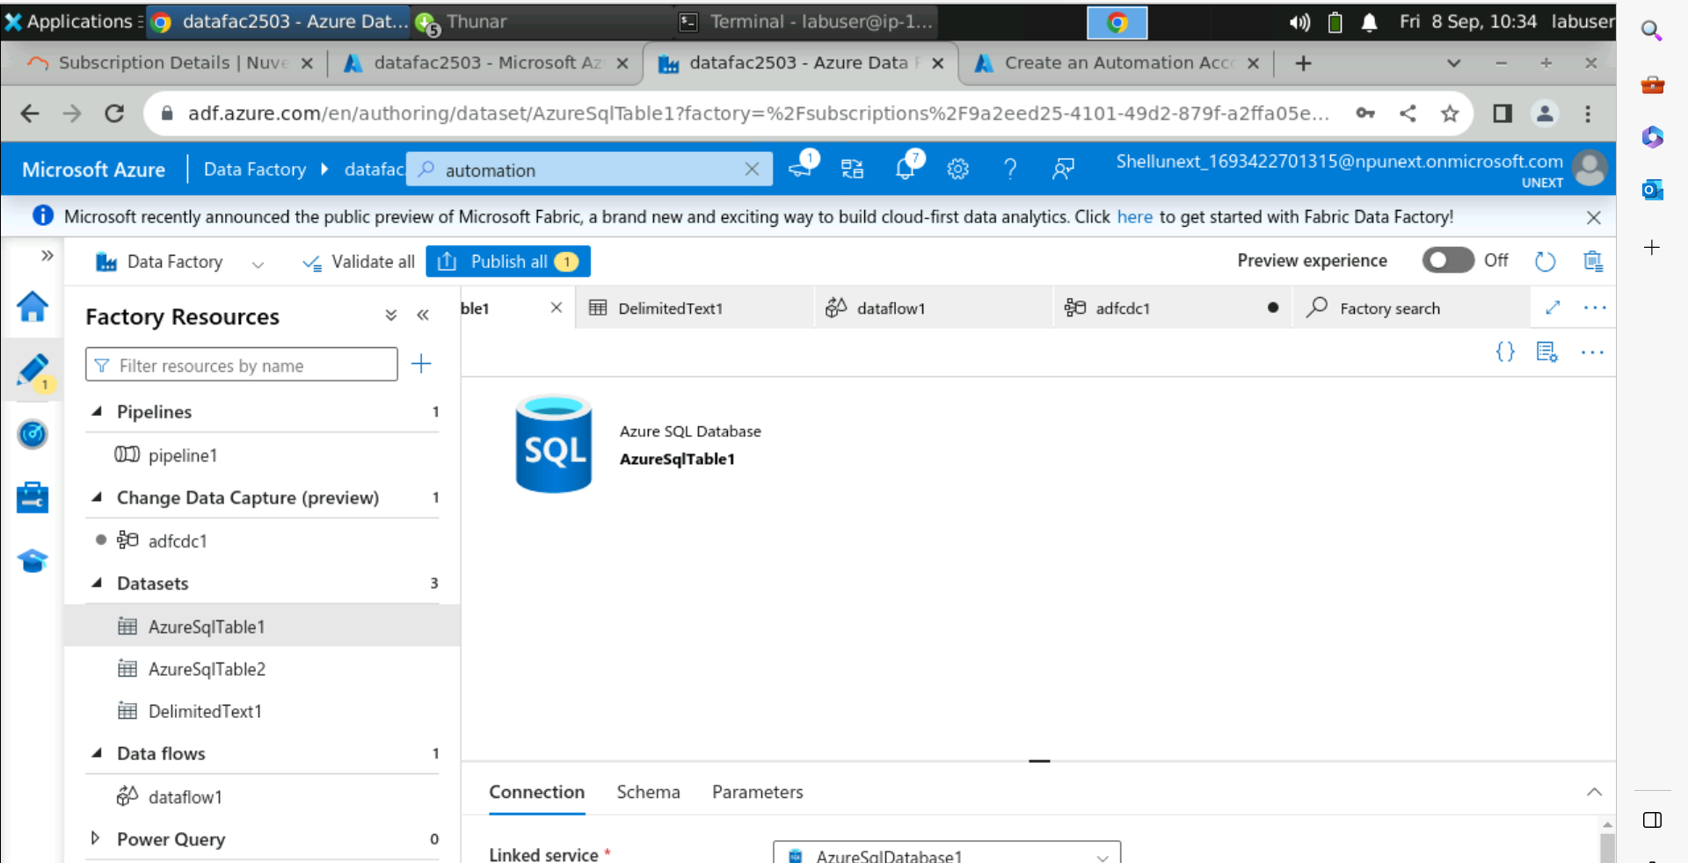

Slide 12
